Slide 1
Attention Is All You Need Paper review
모바일시스템공학과
이승재

Slide 2
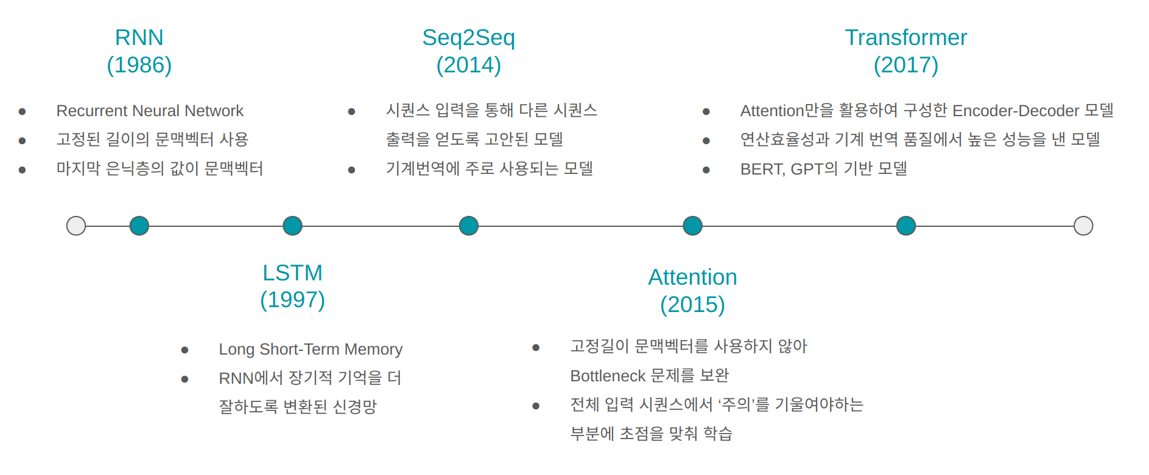
1. Introduction

Slide 3
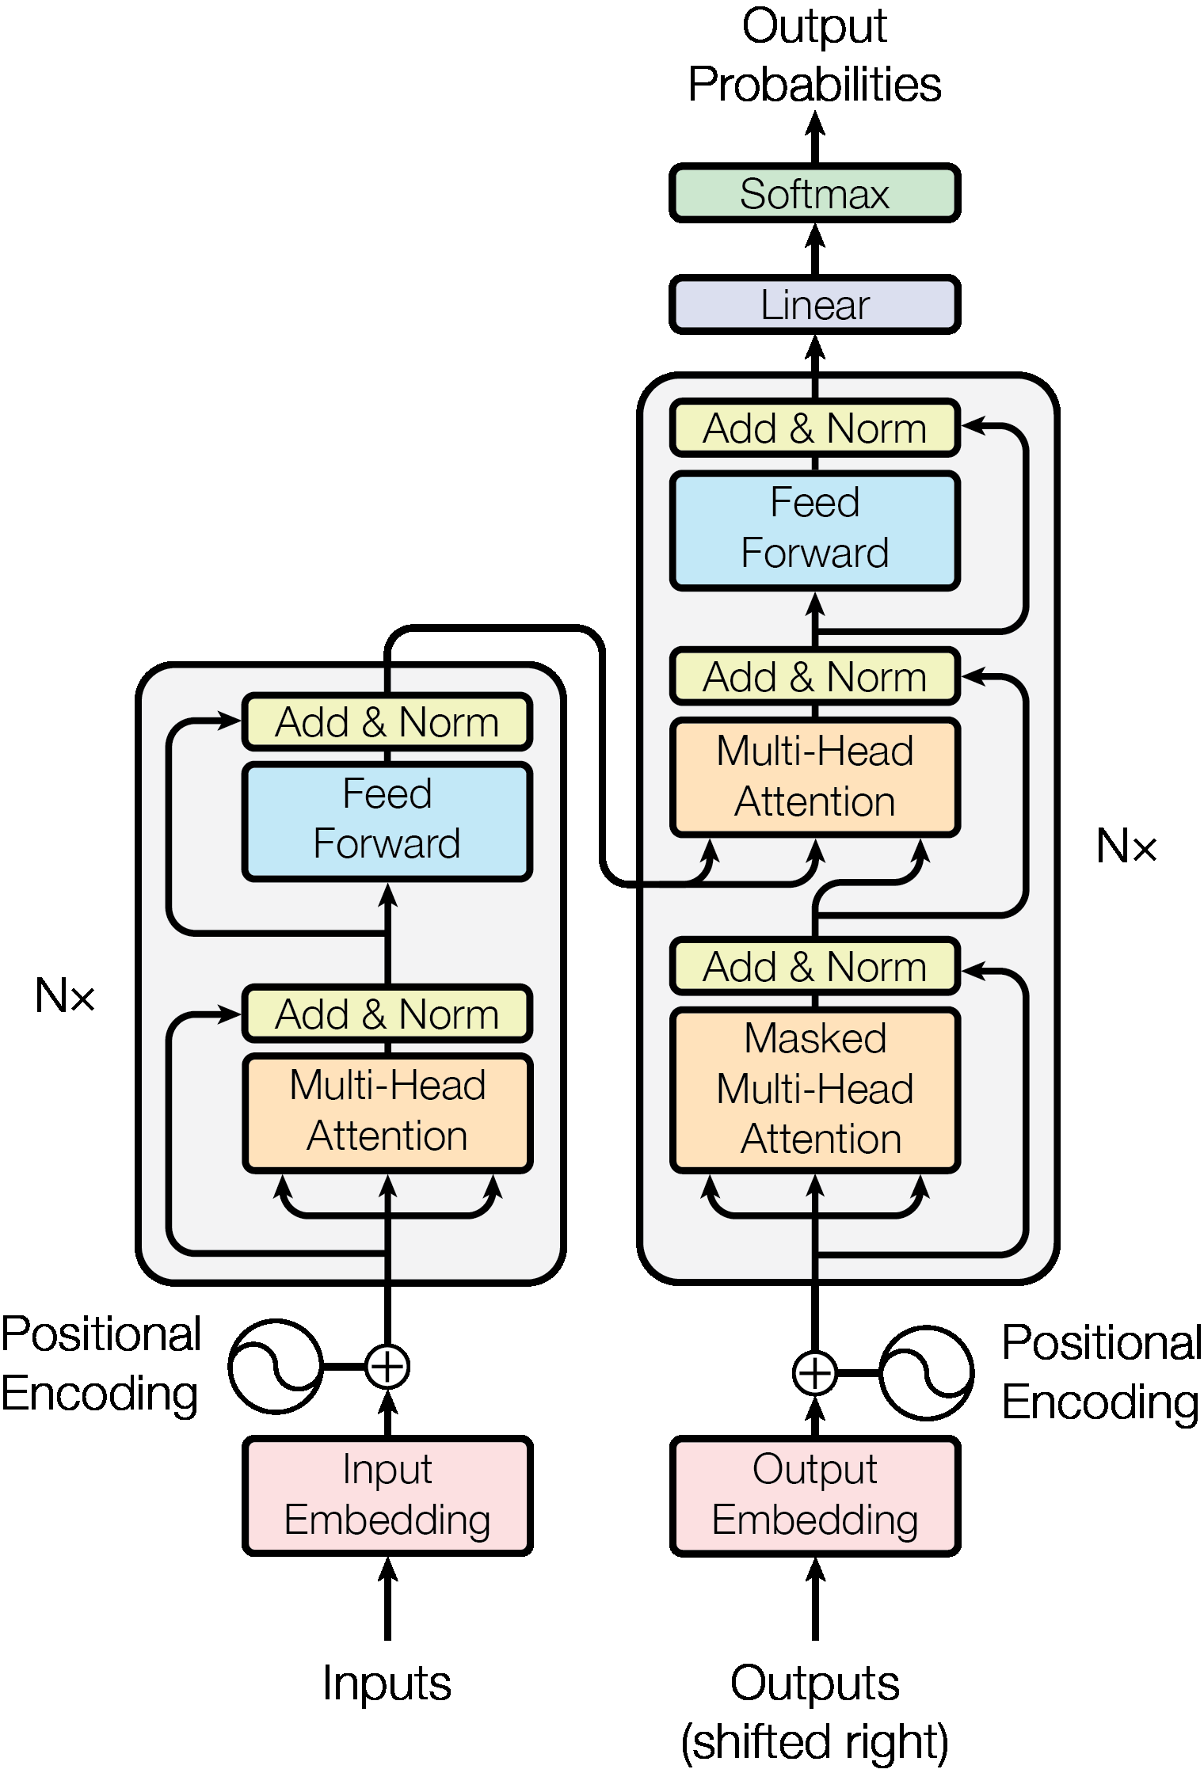
2. Background – overall architecture
“The Transformer model consists of an encoder-decoder architecture designed for sequence-to-sequence tasks, such as machine translation.”

Slide 4
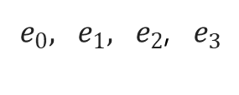
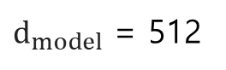
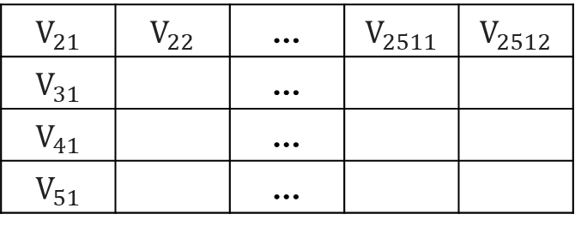
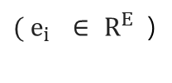
2. Background – partial architecture (Input Embedding)
“In the Input Embedding step of the Transformer, Input sentences are processed and converted into numerical vectors that the model can understand.”
$d_{model}$ = 512
Tokenization
Embedding
“I am a student”
[I, am, a, student]
$e_{0}{, e}_{1}, e_{2}$, $e_{3}$
②
$$V_{21}$$ | $$V_{22}$$ | … | $$V_{2511}$$ | $$V_{2512}$$
$$V_{31}$$ |  | …
$$V_{41}$$ |  | …
$$V_{51}$$ |  | …
②
③
④
⑤
${( e}_{i}$ ∈ $R^{E}$ )
③
④
⑤

Slide 5
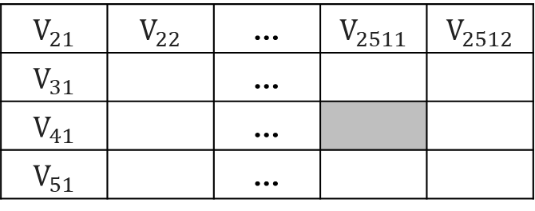

2. Background – partial architecture (Positional Encoding)
"Positional Encoding adds unique, continuous position-specific information to input embeddings using sinusoidal functions, enabling the Transformer to capture sequential relationships without recurrence."
$d_{model}$ = 512
Pos : Token location
(pos, i)
PE(0)
$$V_{21}$$ | $$V_{22}$$ | … | $$V_{2511}$$ | $$V_{2512}$$
$$V_{31}$$ |  | …
$$V_{41}$$ |  | …
$$V_{51}$$ |  | …
i : i-th value of the embedding vector
PE(1)
PE(2)
PE(3)

Slide 6
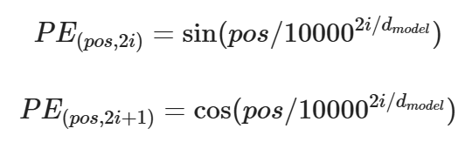
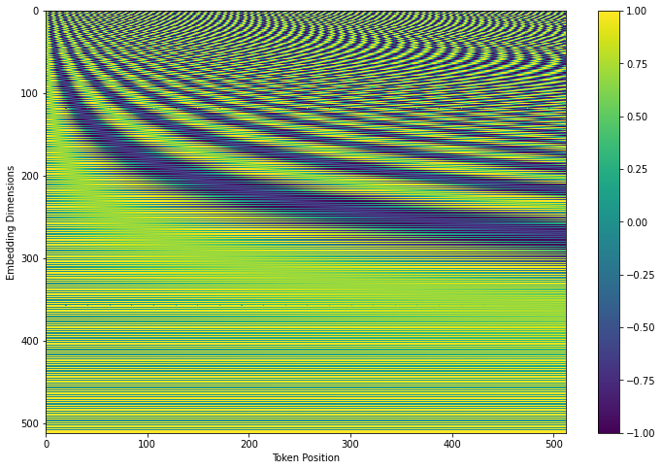
2. Background – partial architecture (Positional Encoding)
"This graph visualizes how Positional Encoding adds positional information to the input data. Based on the following formula, lower dimensions have longer periods, which help in learning relationships between distant words, while higher dimensions have shorter periods, aiding in learning relationships between nearby words."

Slide 7
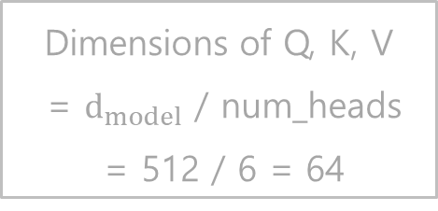
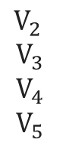
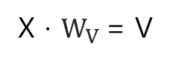
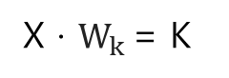
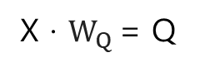
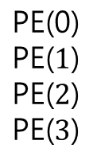
2. Background – partial architecture (Intrance of Self-Attention)
X · $W_{Q}$= Q
Dimensions of Q, K, V = $d_{model}$ / num_heads = 512 / 6 = 64
$$\begin{matrix}V_{2 } \\ V_{3} \\ V_{4} \\ V_{5} \end{matrix}$$
$$\begin{matrix}\text{PE}\text{(0)} \\ \text{PE}\text{(}1\text{)} \\ \text{PE}\text{(}2\text{)} \\ \text{PE}\text{(}3\text{)} \end{matrix}$$
X
⊕
X · $W_{k}$= K
X · $W_{V}$= V
<4 x 512>
<4 x 512> · <512 x 64> = <4 x 64>

Slide 8
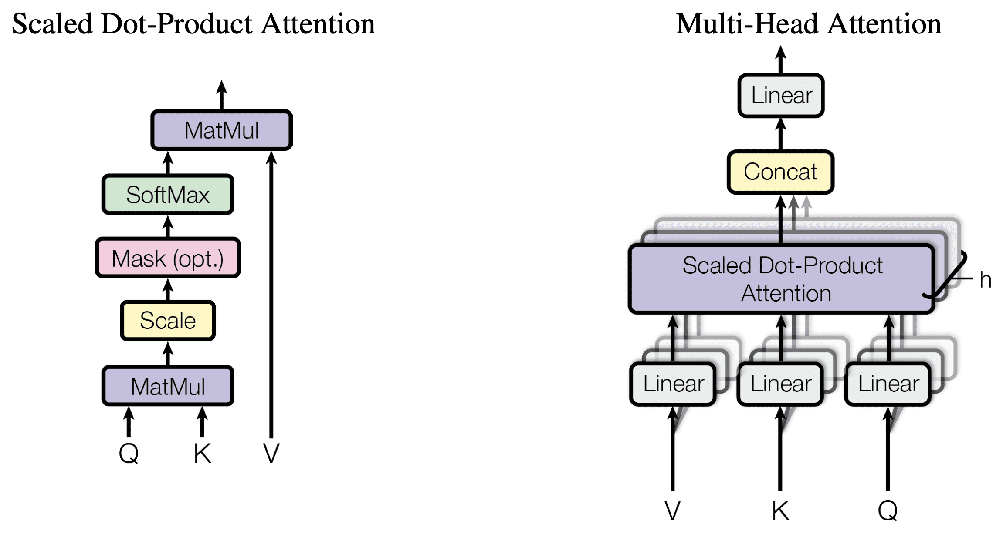
2. Background – partial architecture (Multi-Head Self Attention)
"Multi-Head Self-Attention splits the input into multiple heads, enabling the model to understand the relationships between words in the sequence effectively. Scaled Dot-Product Attention is applied independently to each head, and the results are concatenated and linearly transformed."

Slide 9
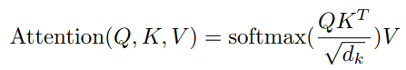
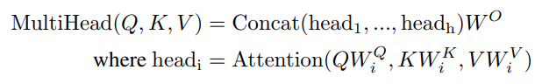
2. Background – partial architecture (Multi-Head Self Attention)
Attention score to be given to the relationship between the i-th token and the j-th token among the entire inner product of Q and K
Weight indicating how important a word is to other words

Slide 10
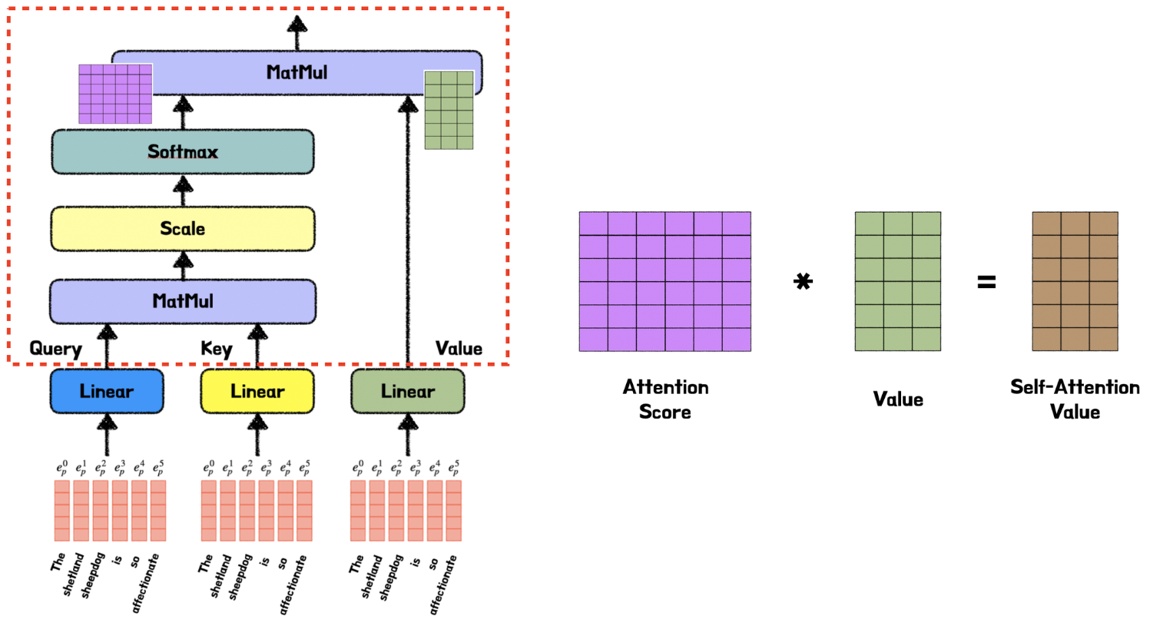
2. Background – partial architecture (Multi-Head Self Attention)

Slide 11
2. Background – partial architecture (Multi-Head Self Attention)
“Self-attention obtains attention through the similarity between tokens in the same sentence, and using multi-head, the model can capture various types of dependencies between input tokens and handle more complex relationships, resulting in richer expressions.”

Slide 12
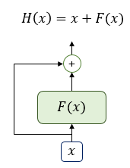
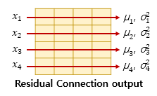
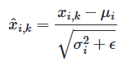
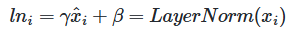
2. Background – partial architecture (Add & Norm)
Residual Connection
Layer Normalization
Multi-head attention output
Multi-head attention input

Slide 13
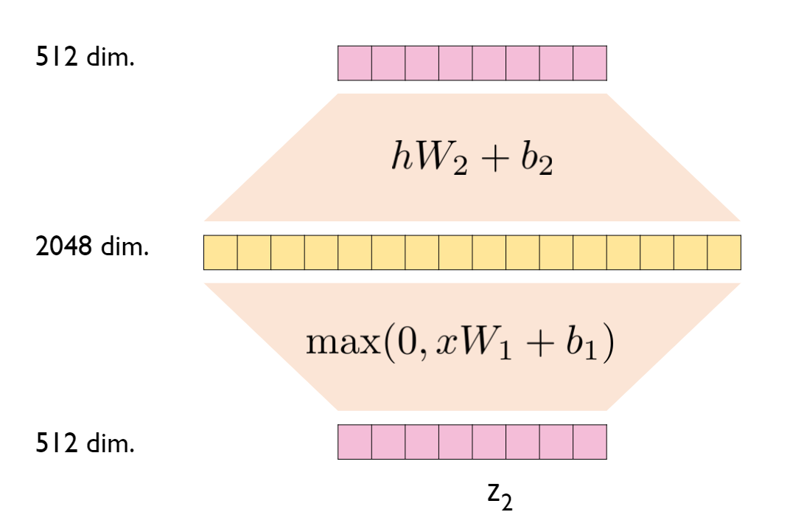
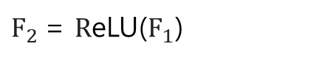
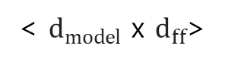
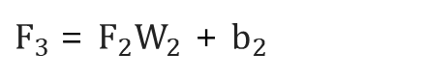
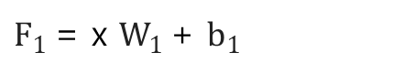
2. Background – partial architecture (Feed Forward)
Fully connected layer
$F_{3}$= $F_{2}W_{2}$ + $b_{2}$
$F_{2}$= $R$eLU($F_{1}$)
Fully connected layer
$F_{1}$= x $W_{1}$+ $b_{1}$
< $d_{model} \text{x} d_{ff}$>
"In the Feed-Forward stage, dimensional expansion allows the model to not only learn relationships between words but also enhance the features of individual words. This process improves the model's representational power while maintaining the same input dimensions, aiding in effective learning."

Slide 14
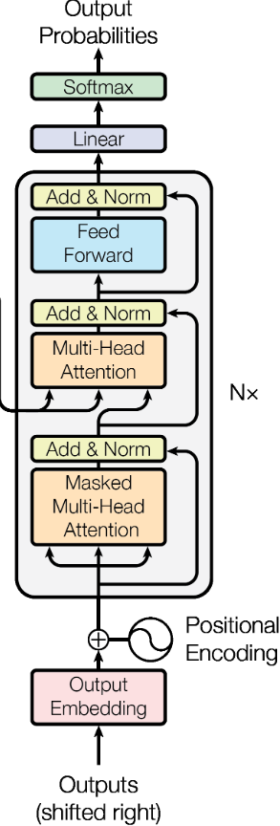

2. Background – partial architecture (Masked Multi-Head Self Attention)

Slide 15
2. Background – partial architecture (Masked Multi-Head Self Attention)
<sos>
I
am
a
student
<eos>
 | -inf | -inf | -inf | -inf | -inf
 |  | -inf | -inf | -inf | -inf
 |  |  | -inf | -inf | -inf
 |  |  |  | -inf | -inf
 |  |  |  |  | -inf
<sos>
I
am
“When predicting the current word, information about future words can be used, so the Mask technique is used.”
a
student
<eos>

Slide 16
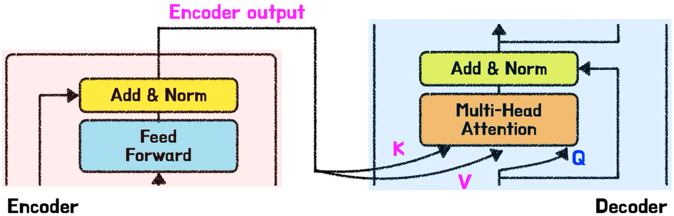
2. Background – partial architecture (Intrance of Encoder-Decoder Attention)
“In Encoder-Decoder Attention, Q, K, and V are generated from different sources. Q is generated from the current output of the decoder, and K and V are taken from the output generated from the entire input sequence processed by the encoder.”

Slide 17
2. Background – partial architecture (Encoder-Decoder Attention)
“Thanks to Encoder-Decoder Attention, the decoder can calculate which part of the input is most relevant to each output. Based on this, the decoder selectively extracts the necessary information from specific parts of the encoder's output, utilizing the most contextually relevant information at the current step. This process helps the decoder make optimal predictions for the input sentence as a whole.”

Slide 18

2. Background – partial architecture (Visualize model operation process)

Slide 19
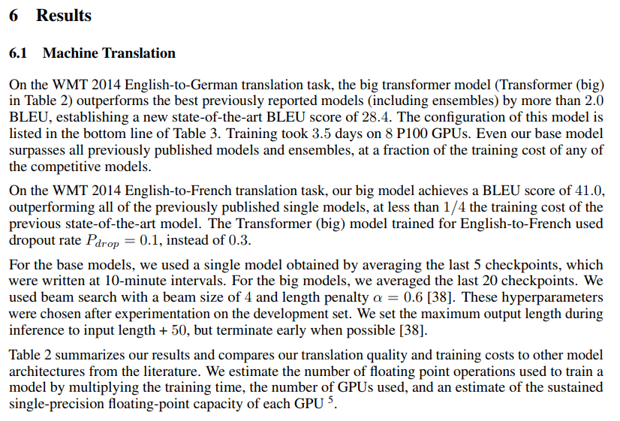
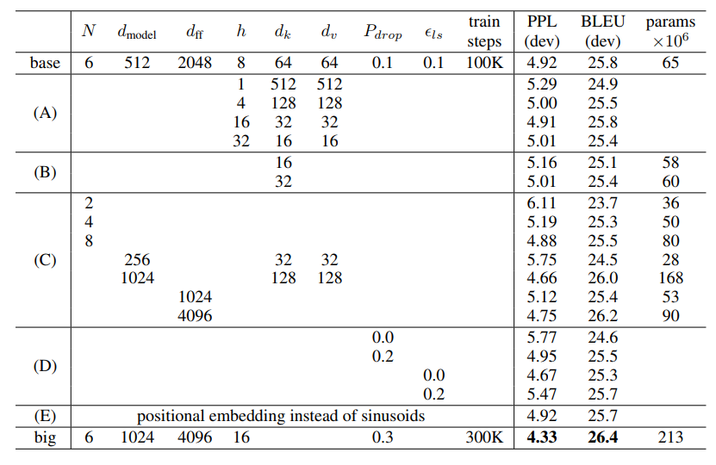
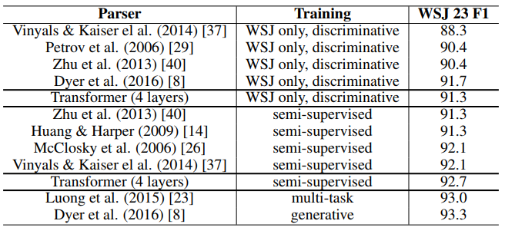
3. Results

Slide 20
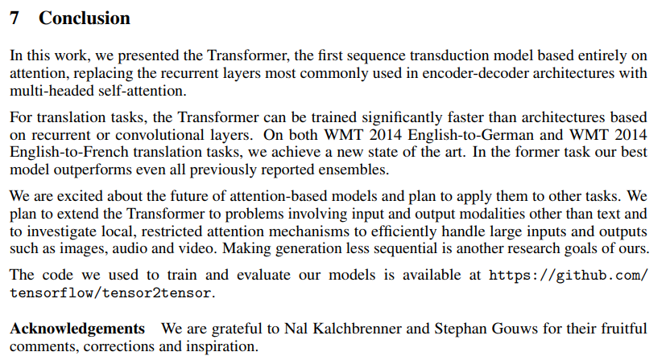
4. Conclusion
“The Transformer is the first model to replace recurrent layers with multi-head self-attention, achieving superior performance and faster training speed in tasks like WMT 2014 English-to-German and English-to-French translation. This model has the potential to be extended to handle various inputs and outputs, including not only text but also images and audio.”

